Slide 1
Hierarchical Attention Networks for Document Classification
Zichao Yang, Diyi Yang, Chris Dyer, Xiaodong He,
Alex Smola, Eduard Hovy, NAACL 2016
Yang, Zichao, Diyi Yang, Chris Dyer, Xiaodong He, Alex Smola, and Eduard Hovy. "Hierarchical attention networks for document classification." In Proceedings of the 2016 Conference of the North American Chapter of the Association for Computational Linguistics: Human Language Technologies, pp. 1480-1489. 2016.
Slides by Aditya Joshi, aditya.joshi@csiro.au, for reading group on 21st January, 2019; Contains screenshots of the paper.

Slide 2
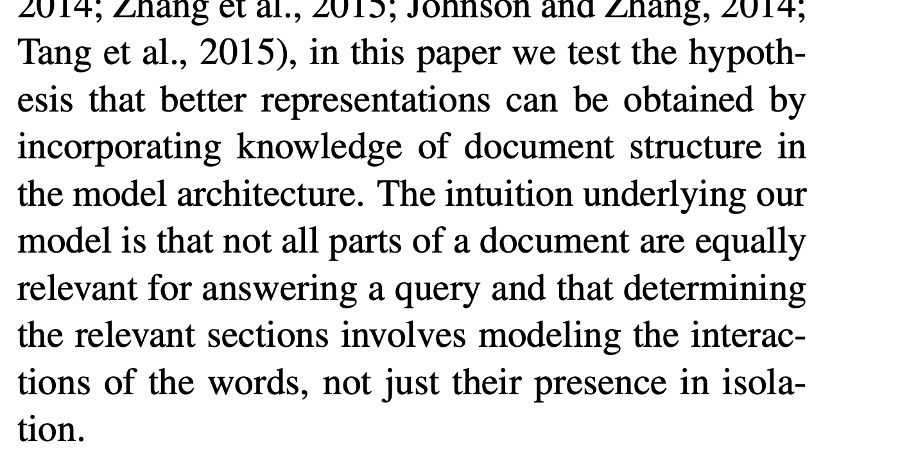
Introduction
Typical text classification applications: topic labeling, sentiment classification, spam detection
Traditional approaches use sparse lexical features, and then a linear model
More recent approaches use CNNs, RNNs, etc.
Hypothesis: “Better representations can be obtained by incorporating knowledge of document structure in the model architecture”
Hierarchical Attention Network (HAN)

Slide 3
Document Structure: Insights
Hierarchy: Word Representation → Sentence Representation → Document Representation
Words and sentences are “Differentially informative”
Therefore, two levels of attention mechanism: word and sentence level

Slide 4
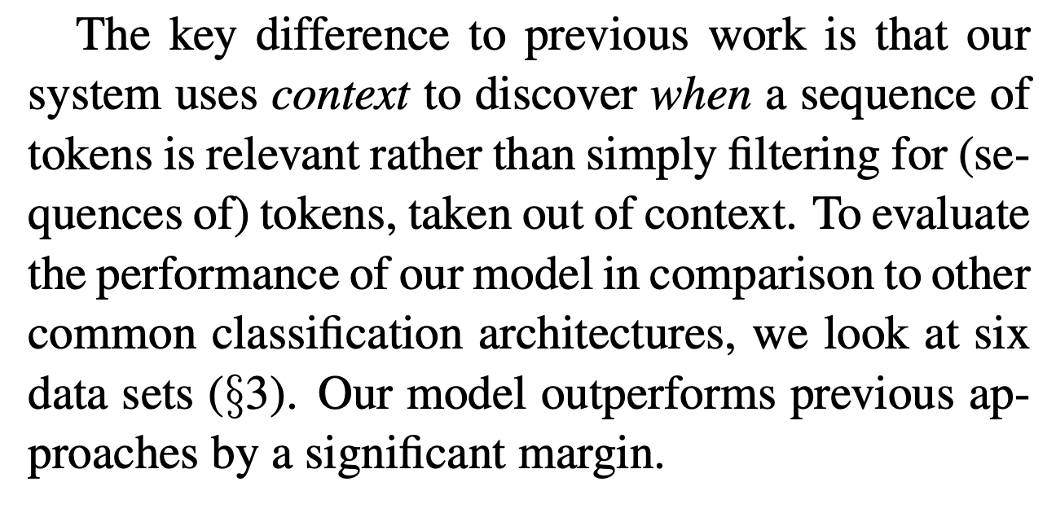

Slide 5
Related Work
Kim (2014) | CNNs for text classification
Zhang et al (2015) | Character-level CNNs for text classification
Socher et al (2013) | Recursive NNs for sentiment classification
Tai et al (2015) | Tree-structured LSTMs to explore the structure of sentences
Lai et al (2015); Zhou et al (2015) | CNN/LSTM to get sentence vector… recurrent neural net to get document vectors
Past work in attention mechanism for MT, image caption generation, parsing, question-answering.
Complete citations skipped due to lack of space. Please refer to the paper.

Slide 6
Related Work
Kim (2014) | CNNs for text classification
Zhang et al (2015) | Character-level CNNs for text classification
Socher et al (2013) | Recursive NNs for sentiment classification
Tai et al (2015) | Tree-structured LSTMs to explore the structure of sentences
Lai et al (2015); Zhou et al (2015) | CNN/LSTM to get sentence vector… recurrent neural net to get document vectors
Past work in attention mechanism for MT, image caption generation, parsing, question-answering.
Complete citations skipped due to lack of space. Please refer to the paper.

Slide 7
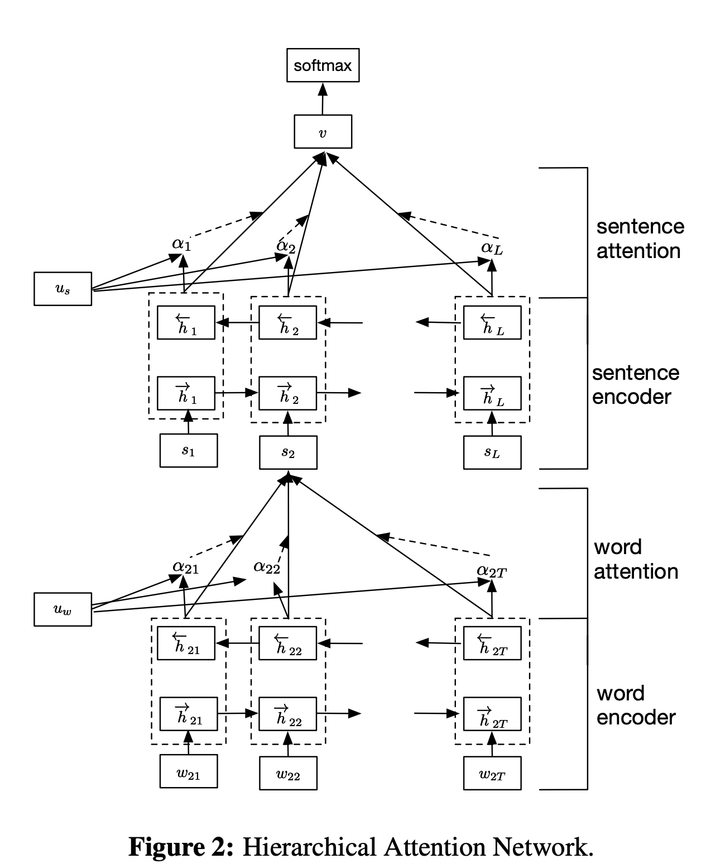
Hierarchical Attention Networks

Slide 8
Hierarchical Attention Networks
Attention(#2.2: Word & Sentence Attention)
GRU-based sequence encoder (#2.1)

Slide 9
Hierarchical Attention Networks: Step-by-step
Attention(#2.2: Word & Sentence Attention)
GRU-based sequence encoder (#2.1)

Slide 10
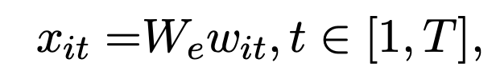
Architecture deconstructed (1)
“We obtain the word embedding by training an unsupervised word2vec (Mikolov et al., 2013) model on the training and validation splits”

Slide 11
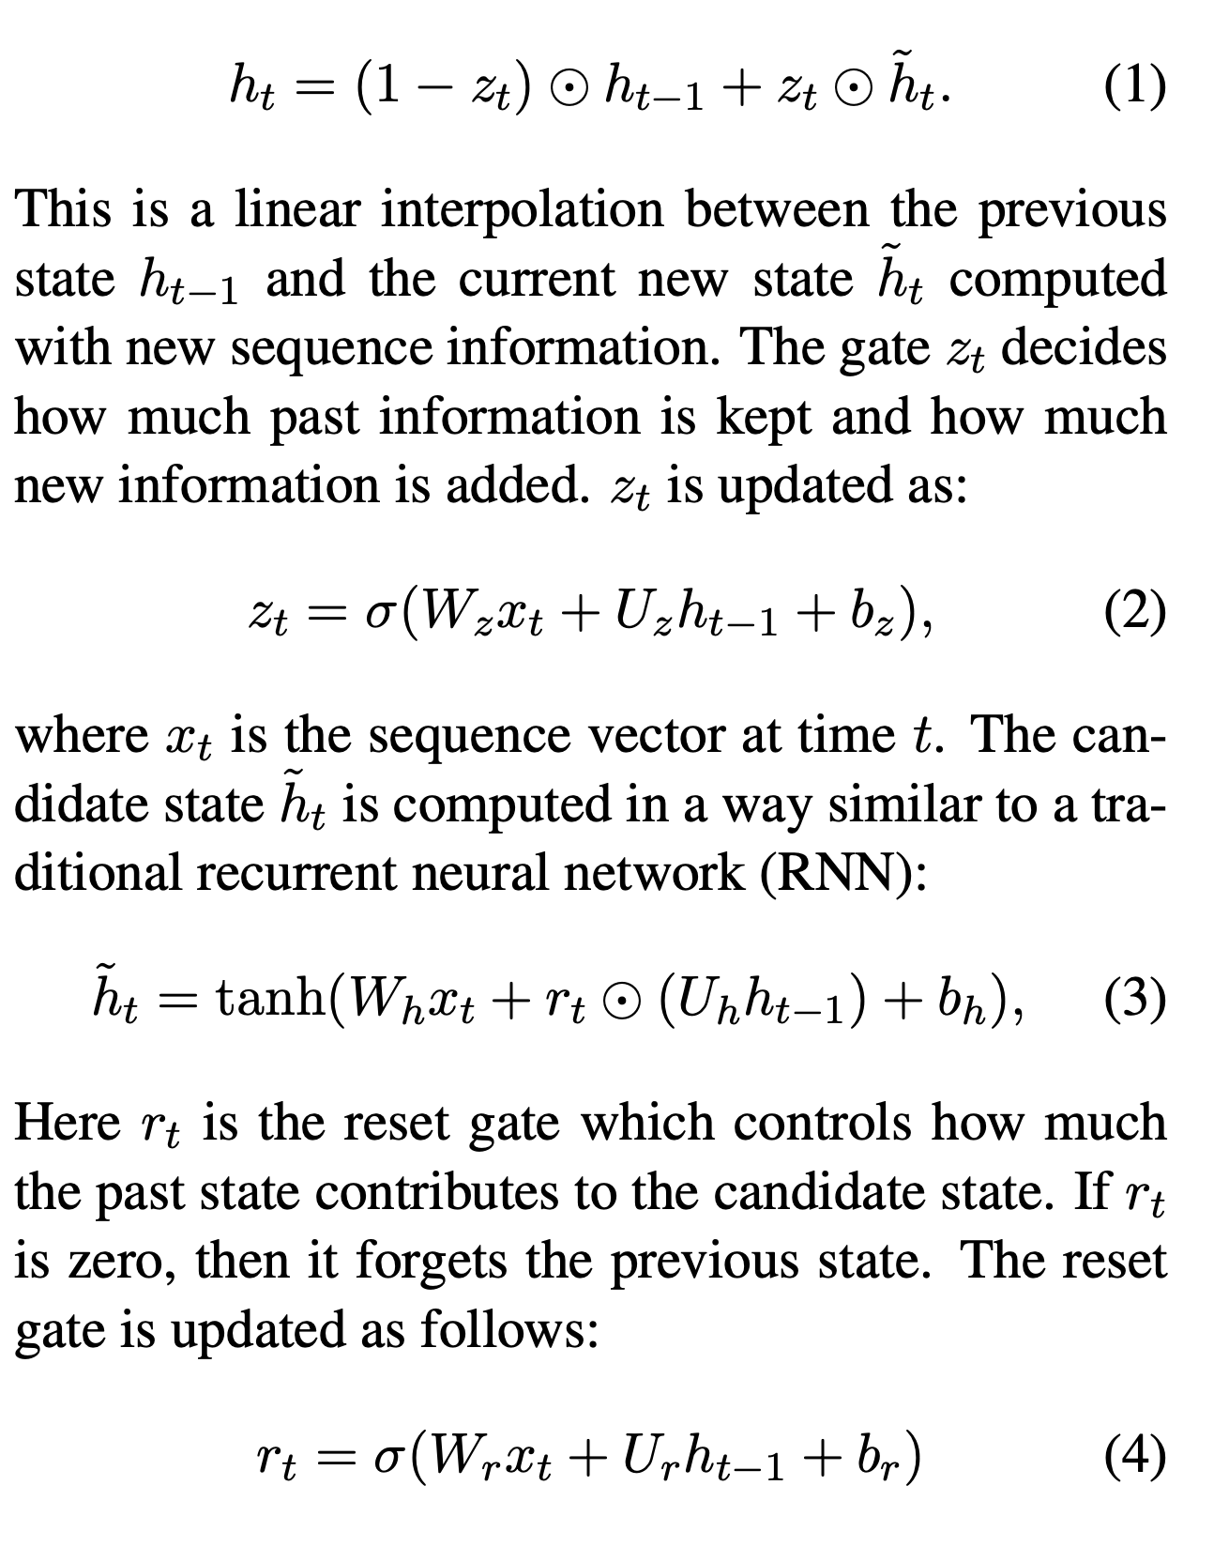
Architecture deconstructed (2)
GRU Image from Wikipedia

Slide 12
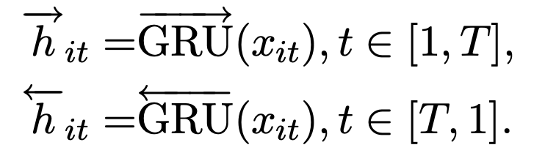
Architecture deconstructed (3)

Slide 13
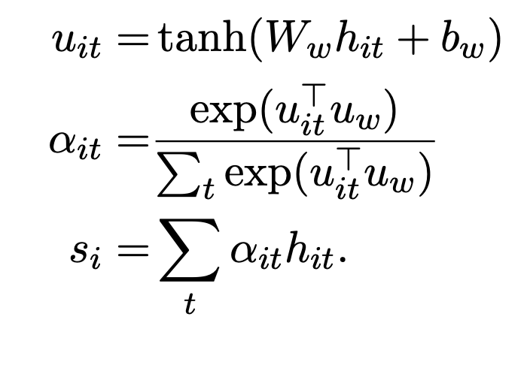
Architecture deconstructed (3)

Slide 14
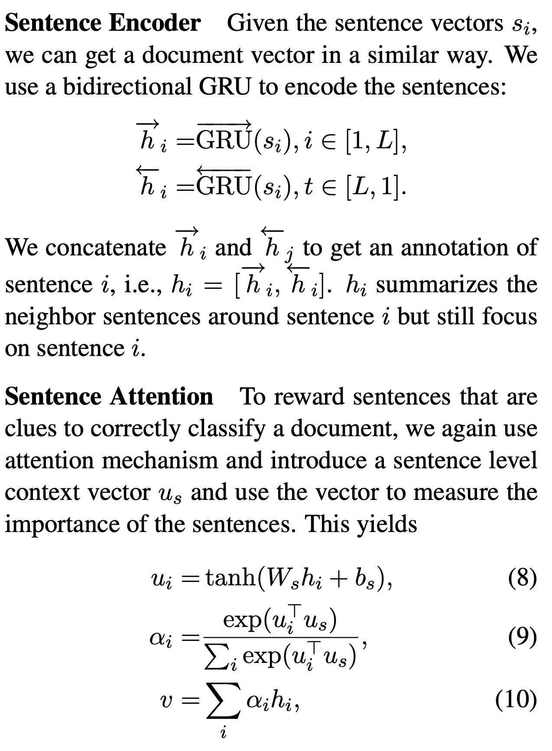
Architecture deconstructed (4)

Slide 15
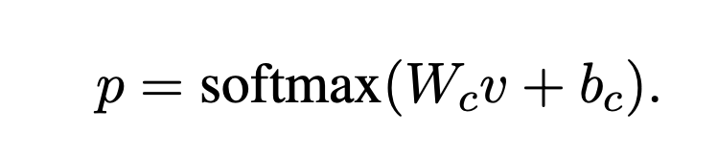
Architecture deconstructed (5)

Slide 16
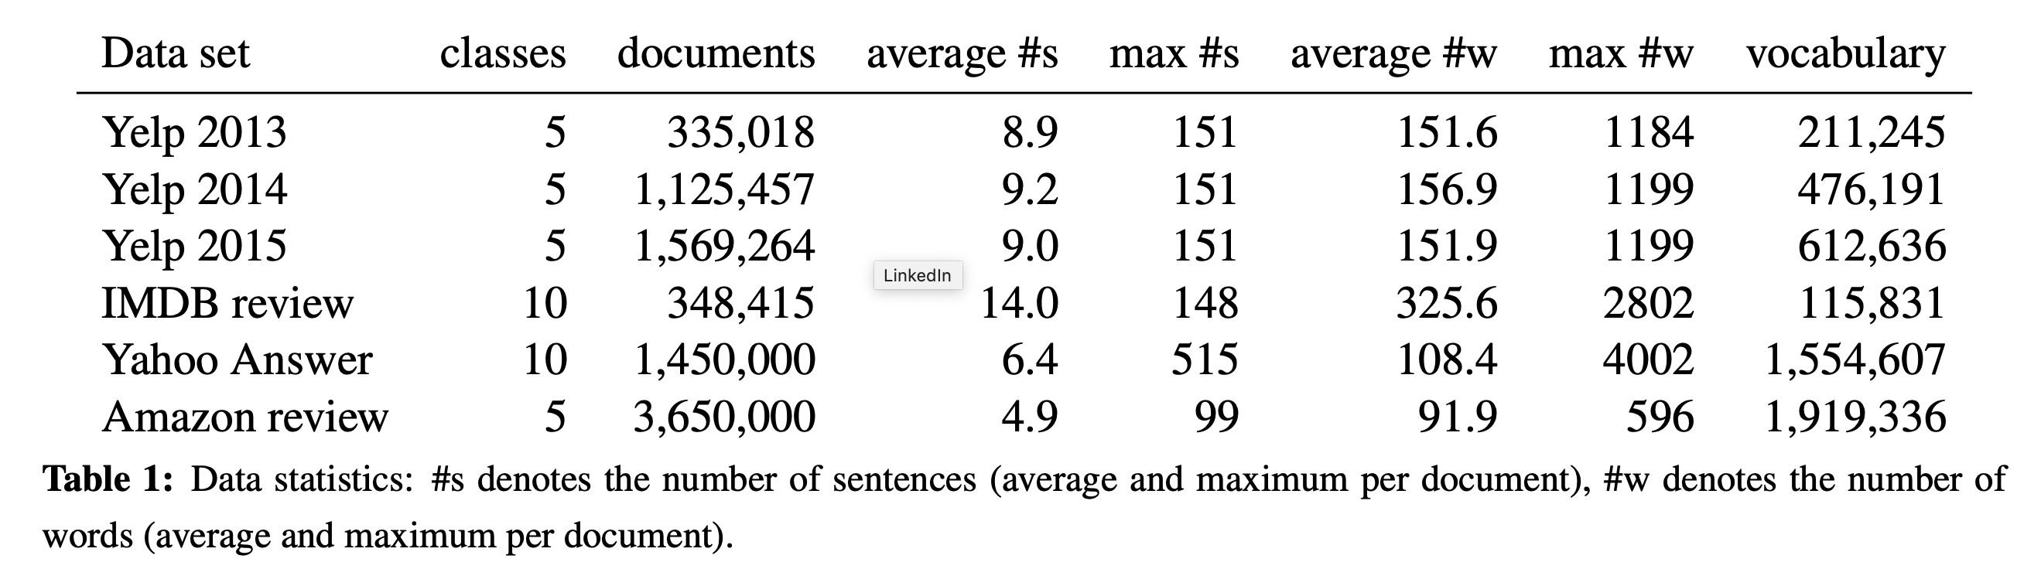
Datasets

Slide 17
Baselines
Logistic Regression
Unigrams
TF-IDF
SVM
Unigrams
Sentence Vector Representations..
DL
CNN-Word
CNN-Char
LSTM
Conv-GRNN..

Slide 18
Experimental Configuration
Dimensions: 200
GRU Dimensions: 50; Total: 100
Batch size: 64;
HN-{AVE, MAX, ATT}. Here HN stands for Hierarchical Network, AVE indicates averaging, MAX indicates max-pooling, and ATT indicates our proposed hierarchical attention model.

Slide 19
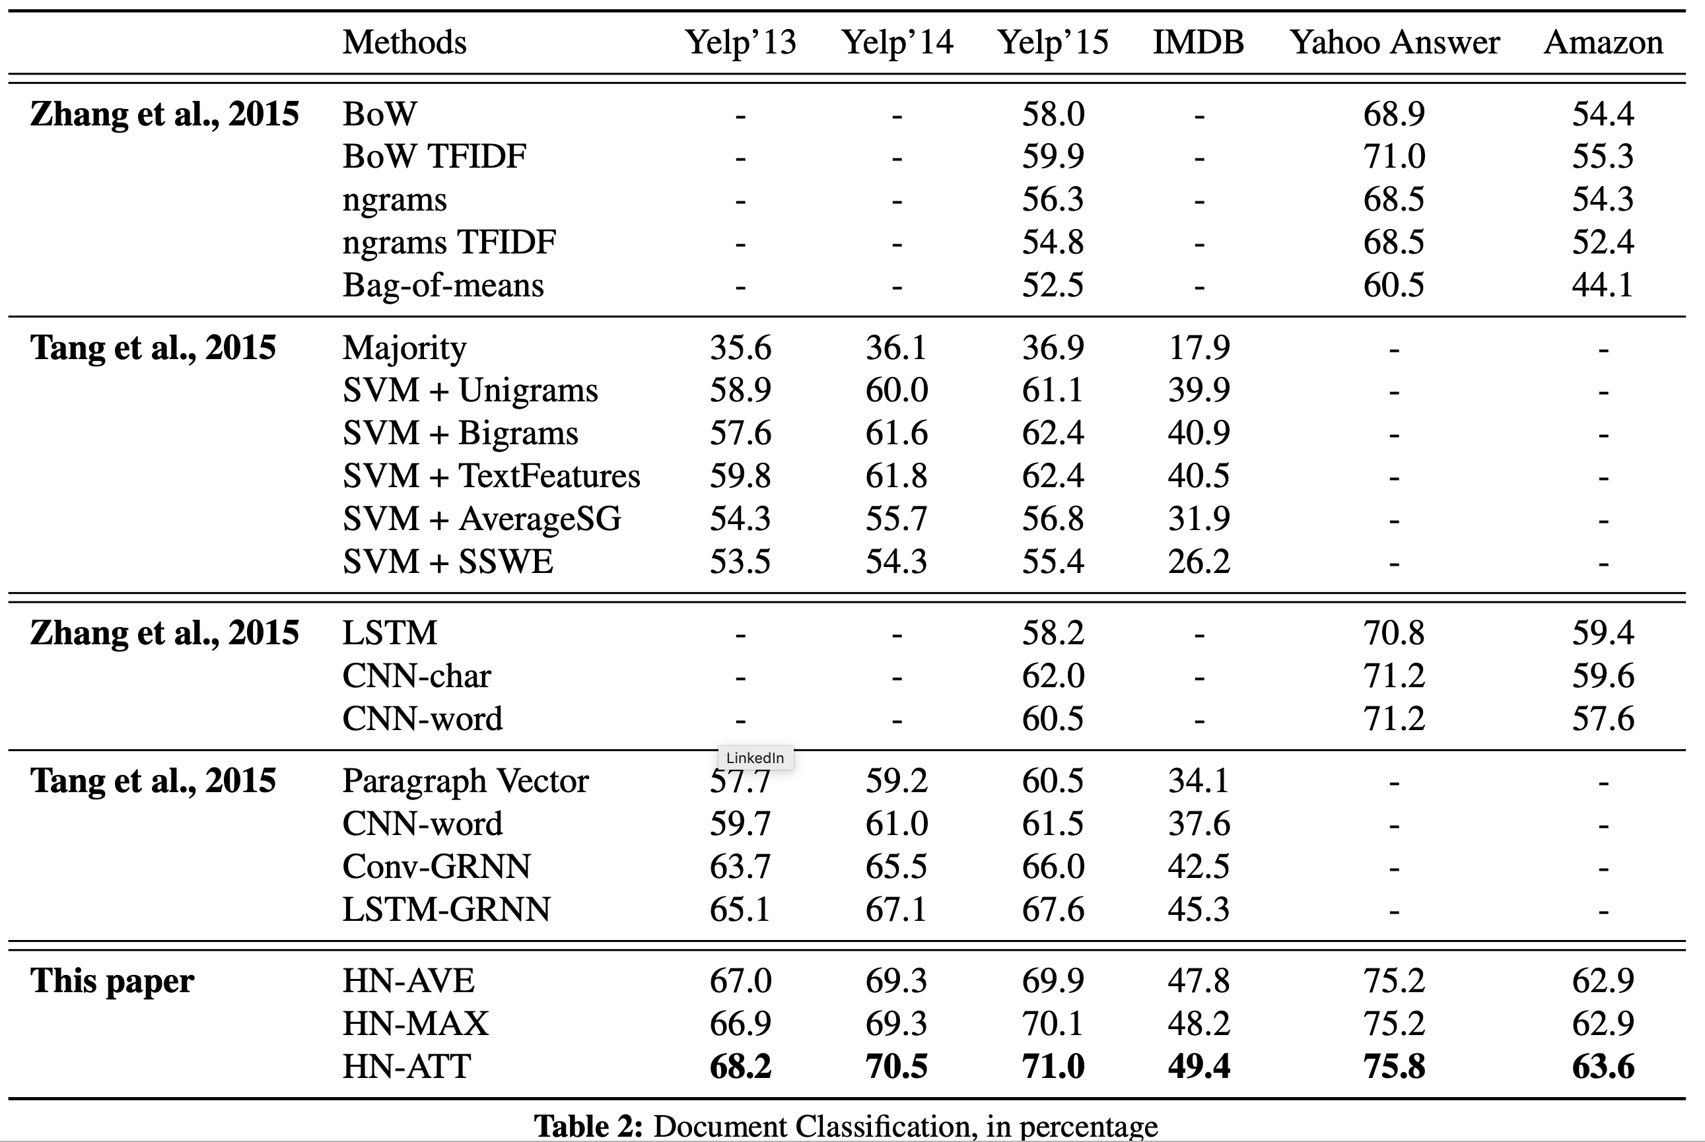
Results: Performance on classification
Reported values are accuracies
Deep learning-based models do not necessarily
outperform traditional approaches
Exploring the hierarchical structure alone
can improve the performance (HNN-AVE/MAX over CNN-word et al)
HN-ATT gives the best performance.

Slide 20
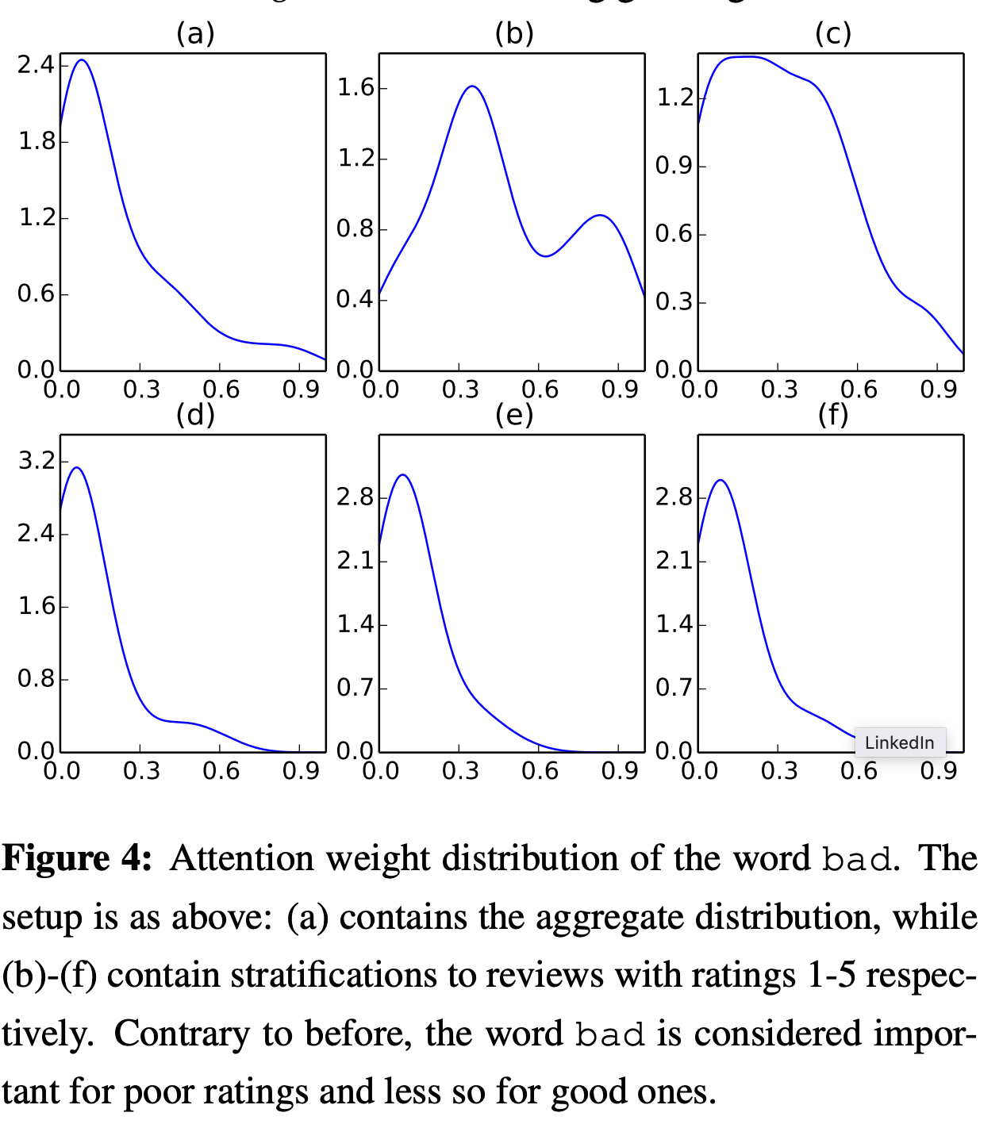
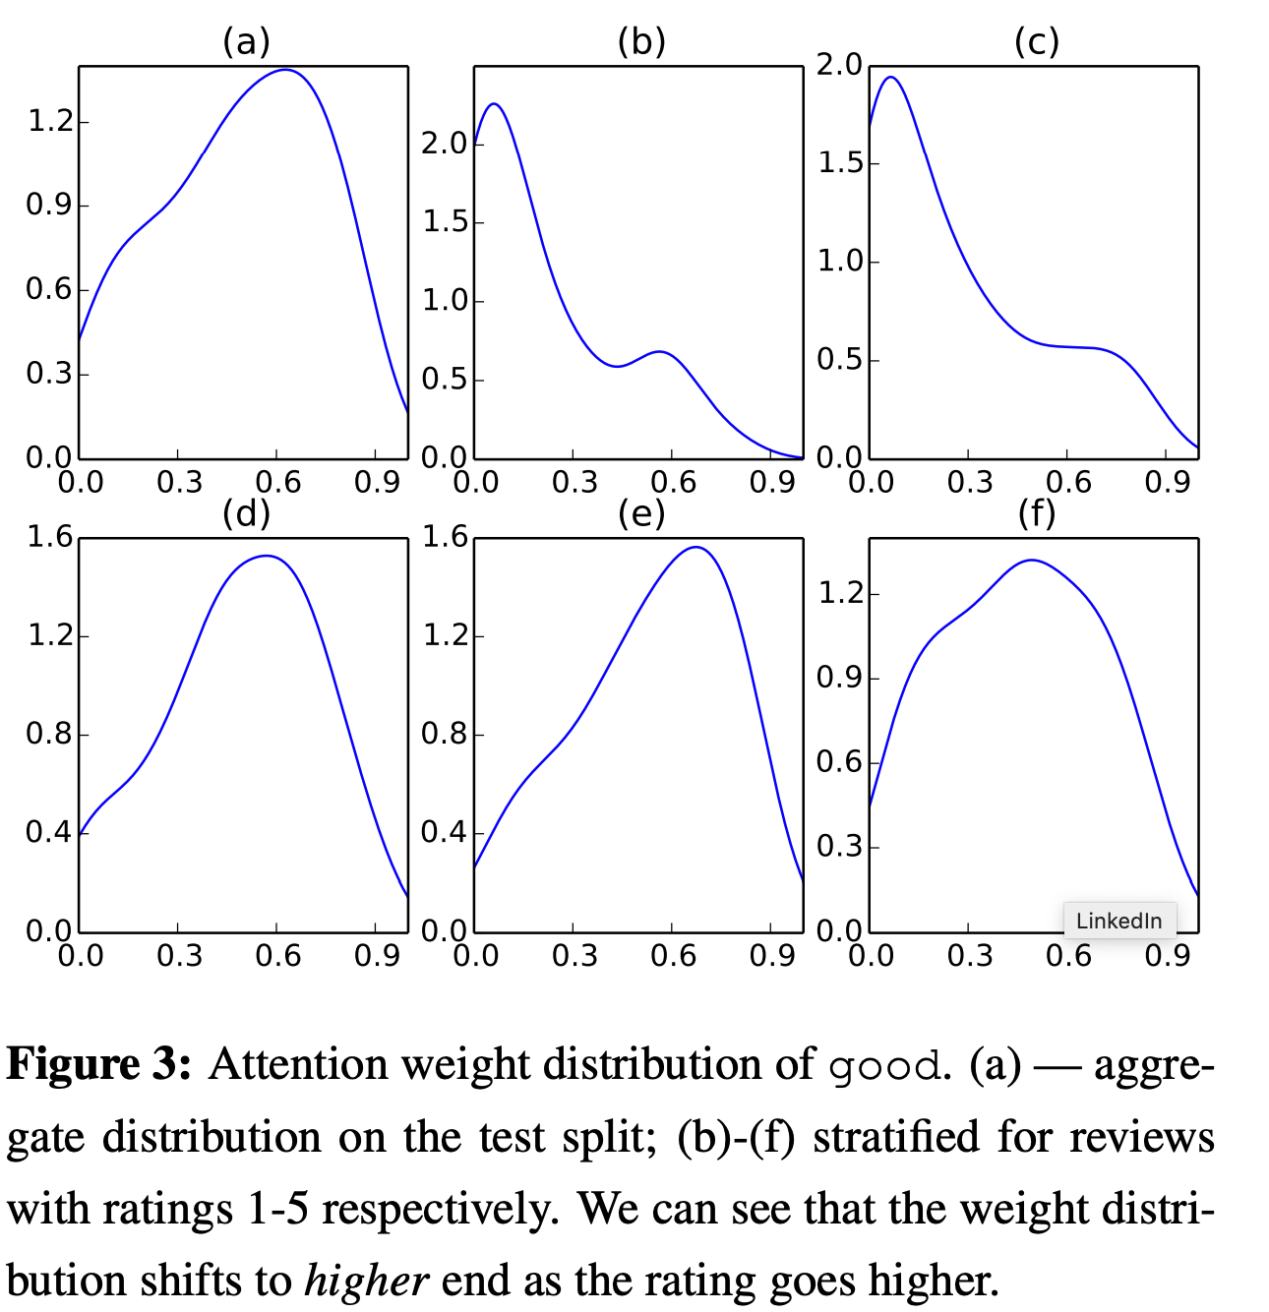
Results: Distribution of attention weights across different classes
What does the Y-axis represent?

Slide 21
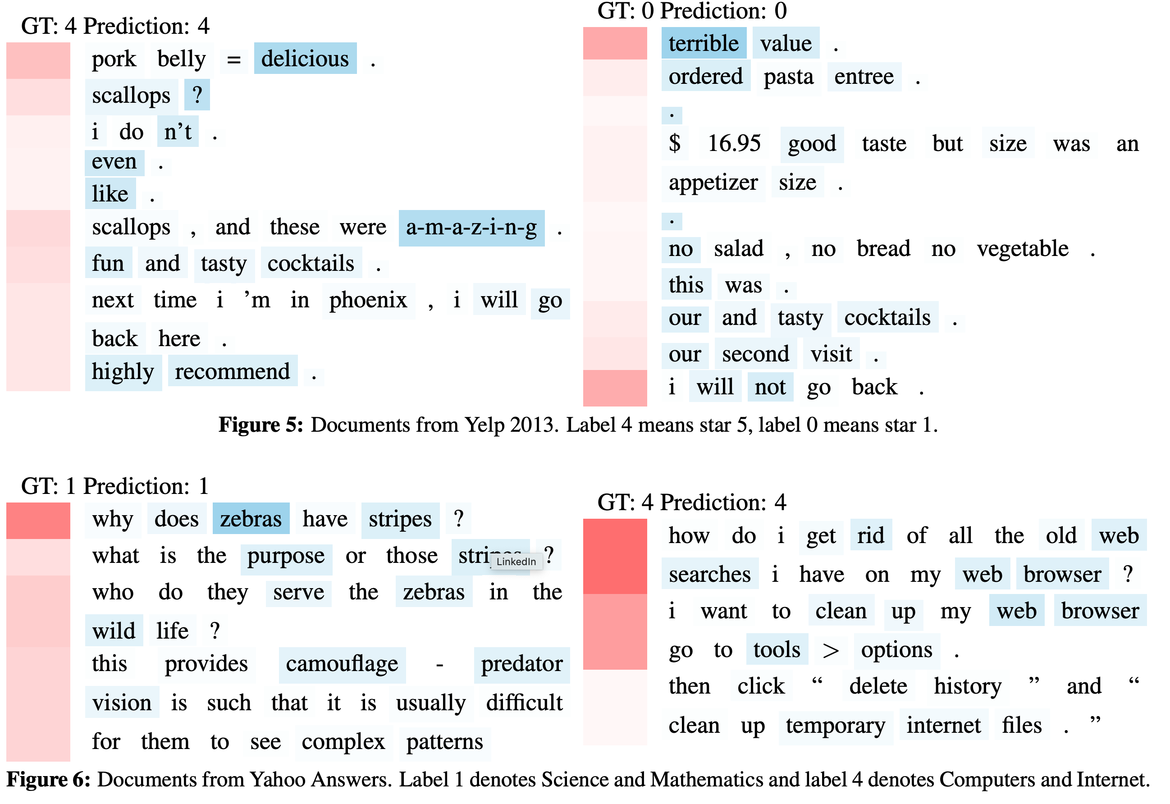
Results: Visualisation of attention

Slide 22
Conclusion
“Hierarchical attention networks (HAN) for classifying documents”
“Progressively builds a document vector by aggregating important words into sentence vectors and then aggregating important sentences vectors to document vectors”
“Experimental results demonstrate that our model performs significantly better than previous methods.”
“Visualization of these attention layers illustrates that our model is effective in picking out important words and sentences.”

Slide 23
end of slides.
Yang, Zichao, Diyi Yang, Chris Dyer, Xiaodong He, Alex Smola, and Eduard Hovy. "Hierarchical attention networks for document classification." In Proceedings of the 2016 Conference of the North American Chapter of the Association for Computational Linguistics: Human Language Technologies, pp. 1480-1489. 2016.
Slides by Aditya Joshi, aditya.joshi@csiro.au, for reading group on 21st January, 2019

